Slide 1

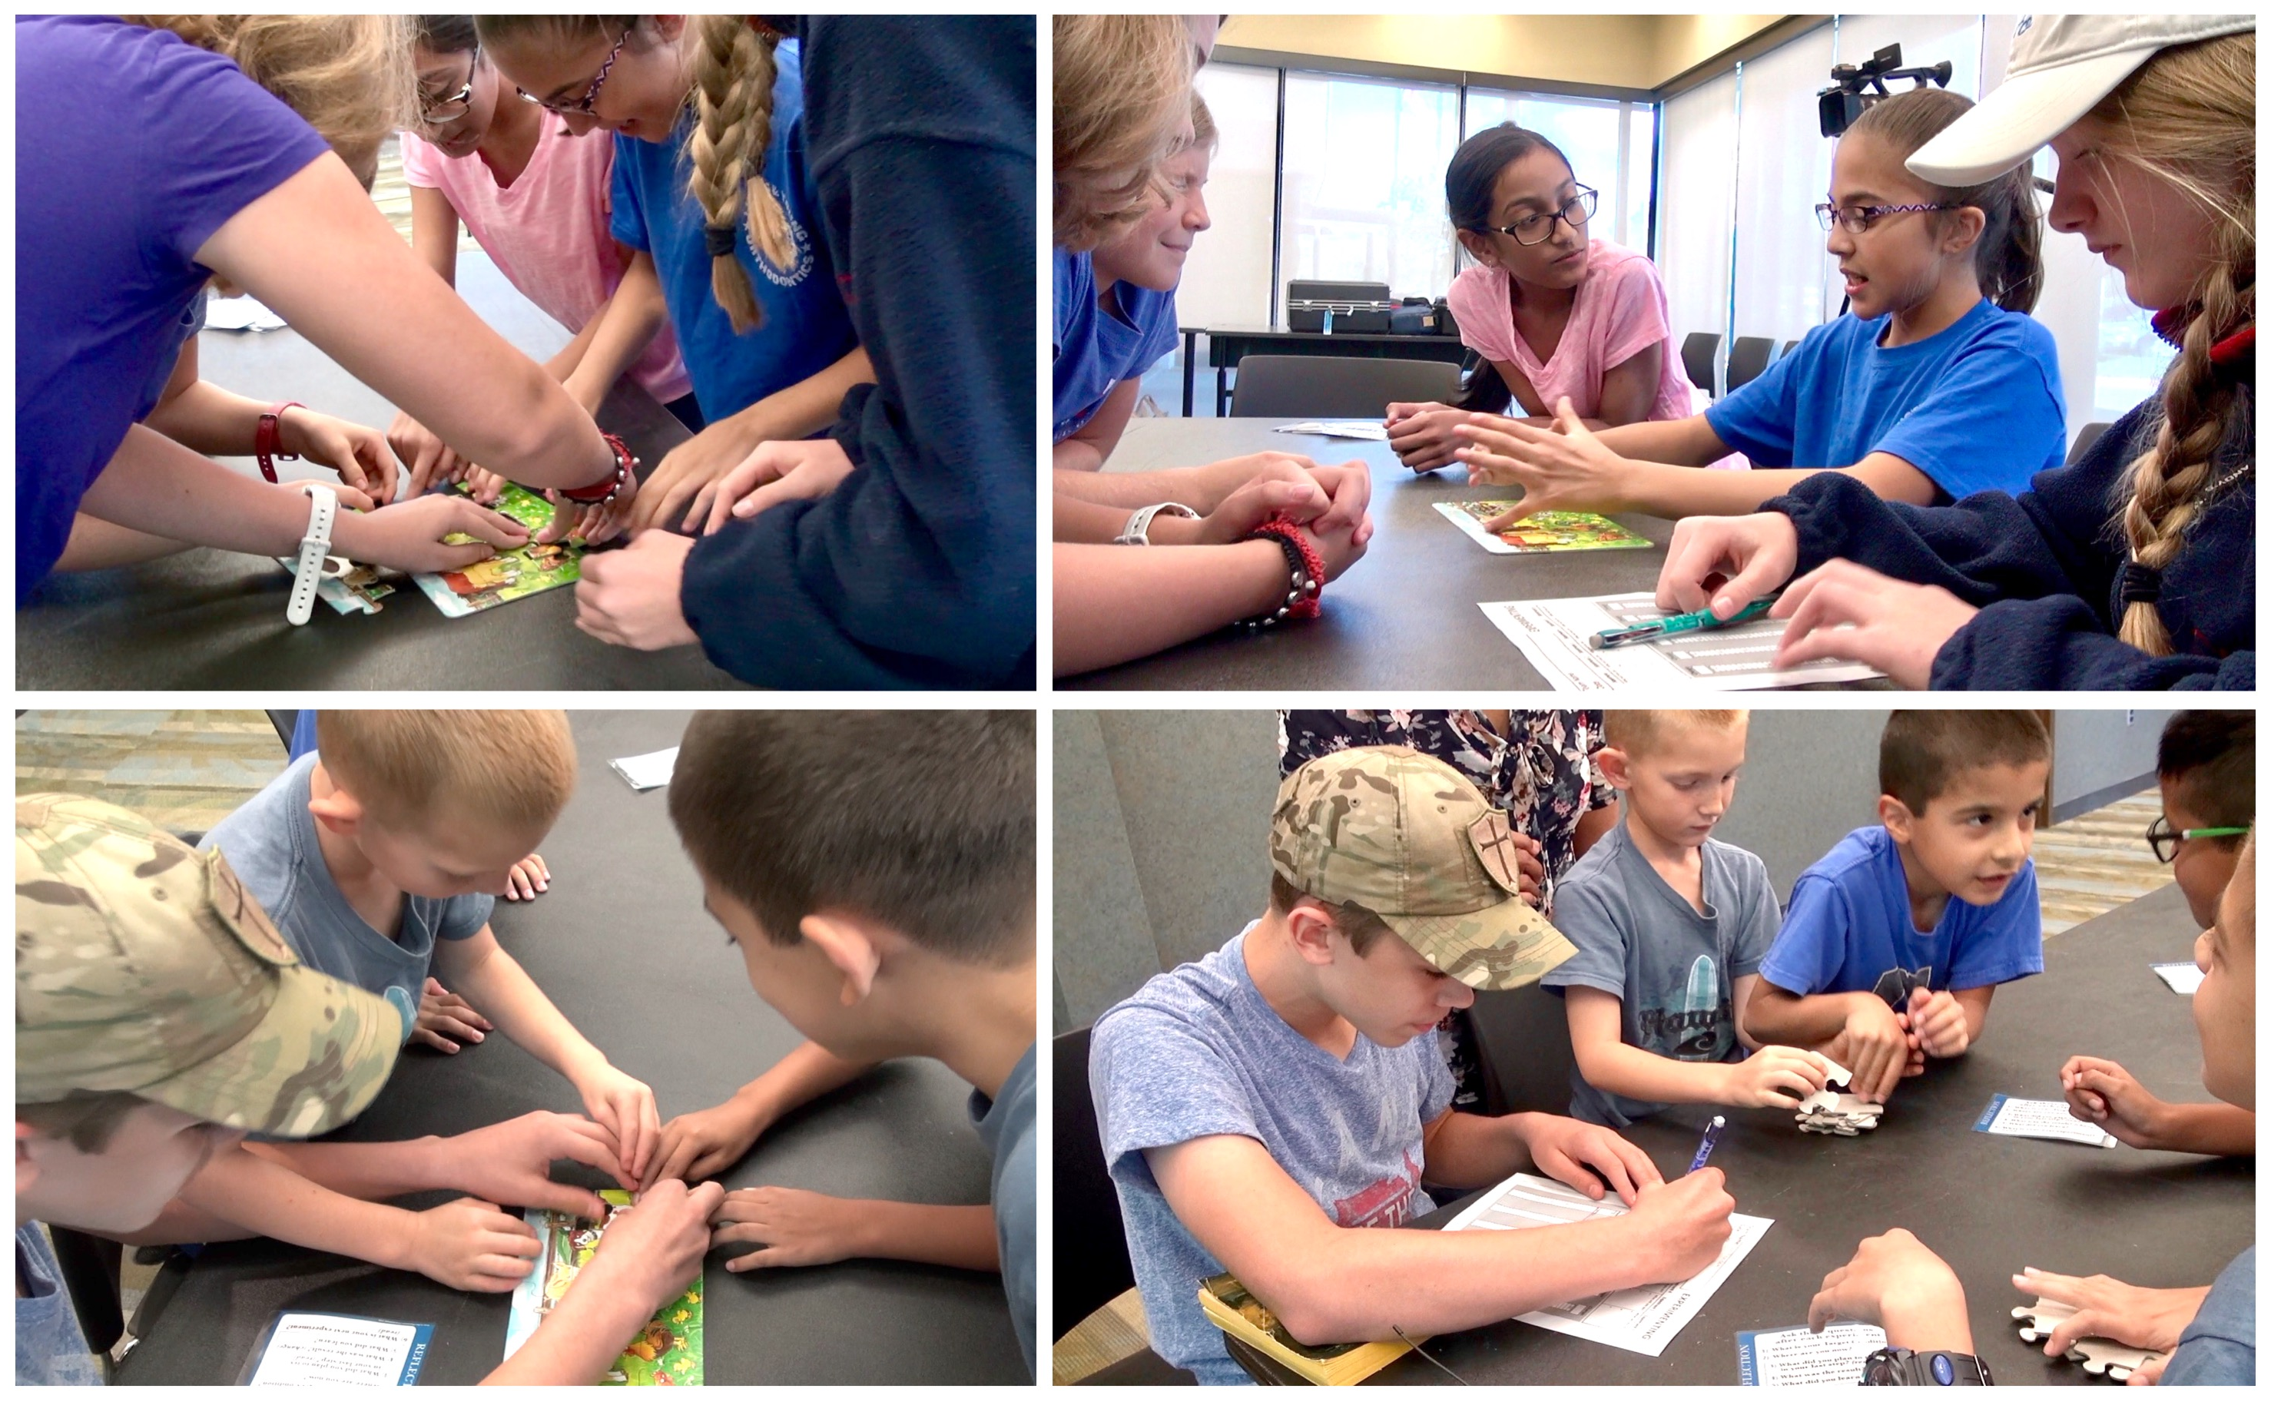
Welcome to the
Kata in the Classroom 1 Exercise!
An easy-to-run 50-minute classroom exercise that
helps you teach scientific thinking and adaptiveness
www.katatogrow.com
v6.7
Notes:
Welcome. Hope you love this exercise and the Improvement Kata pattern. ☺

Slide 2


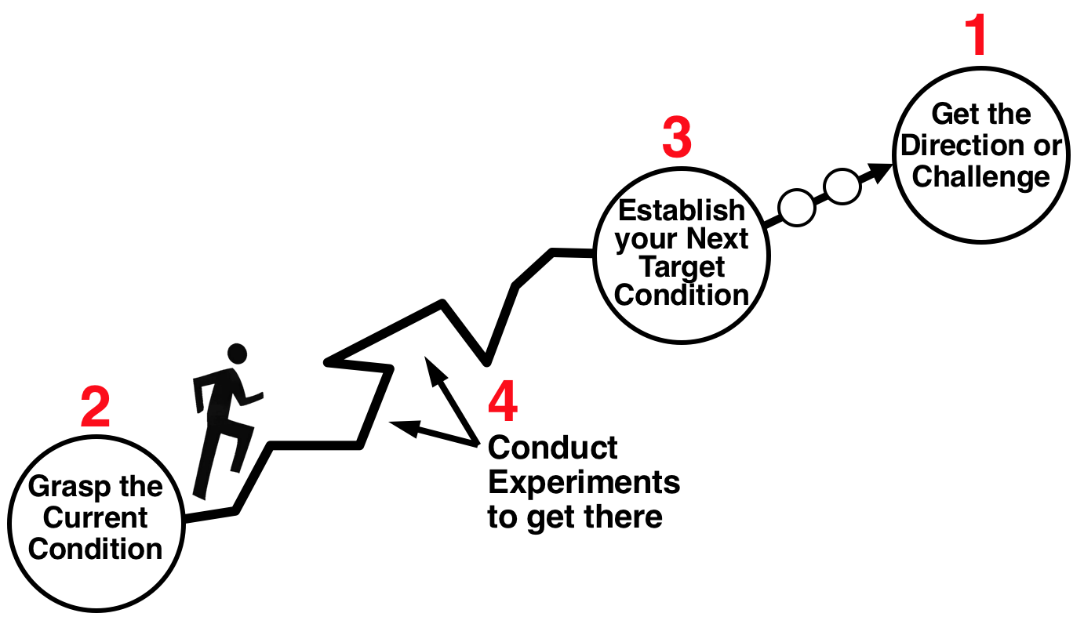

The KiC-1 and KiC-2 exercises support the content you’re already using in your classroom
After you run the KiC-1 exercise, which introduces the scientific
4-step “Improvement Kata” pattern, you can apply that pattern to nearly any content and activity. This way that content or activity
also becomes practice in meta-cognitive skills.
The second, follow-on KiC-2 exercise helps
prepare students to apply the IK pattern
in projects that involve data.
KiC materials are licensed under a Creative Commons Attribution-NonCommercial-ShareAlike license.
You are free to copy, use, remix, transform, build upon and redistribute
them. Just note the source as katatogrow.com. However, these materials
may not be used for sale in any form. Use them, adapt them, share them!
THIS SLIDE IS NOT PART OF THE EXERCISE
Notes:
(Comments for the instructor)

Slide 3
This KiC-1 exercise has two main lessons:
(1) Introduction to the four steps of the Improvement Kata
pattern. The IK is a simple, practical scientific-thinking
pattern that is easy to apply in everyday life.
(2) Recognize that any idea we have needs to be tested,
no matter how certain we might feel about it.
Lesson #2 above may be the most vital aspect of scientific thinking.
Note that the KiC-1 exercise takes two non-scientific shortcuts, which are used as teaching opportunities in the KiC-2 exercise:
  • Students can change more than one variable at a time.
  • Students collect only 1 data point before designing the next experiment.
THIS SLIDE IS NOT PART OF THE EXERCISE
Notes:
(Comments for the instructor)

Slide 4

INTRODUCTION
Kata in the Classroom (KIC) is a ~50-minute hands-on exercise to introduce the scientific pattern of the Improvement Kata in school classrooms. It was originally targeted at Middle School Science teachers, but is now used in all sorts of K-12 and college educational settings. KiC involves the team activity of assembling a 15-piece cardboard jigsaw puzzle several times, and experimenting with ways to do it faster.
The KIC exercise combines a practical scientific pattern (the "Improvement Kata") with techniques of deliberate practice, to help you make scientific thinking a teachable skill that anyone can learn. Teams of students (a) establish a baseline, (b) face a Challenge, (c) develop a next Target Condition on the way to the Challenge and (d) conduct experiments toward that Target Condition. While the students are engaged in a hands-on game they are simultaneously being introduced to a scientific meta skill.
KiC helps you teach universal STEM skills for achieving challenging goals along uncharted paths:
Scientific & Creative Thinking - generate and refine solutions to obstacles through experimentation.
Collaboration - work in a team to accomplish a next goal on the way to a larger challenge.
Communication - organize thoughts, data & findings, and share them effectively.
Once you run the KiC-1 exercise, use the four-step Improvement Kata pattern as a working pattern, or overlay, for other activities throughout the school year. Where else might your students apply and practice the four-step pattern of the Improvement Kata? Visit www.katatogrow.com for examples of how educators are practicing the Improvement Kata pattern in their classrooms.
Notes:
(Comments for the instructor)

Slide 5
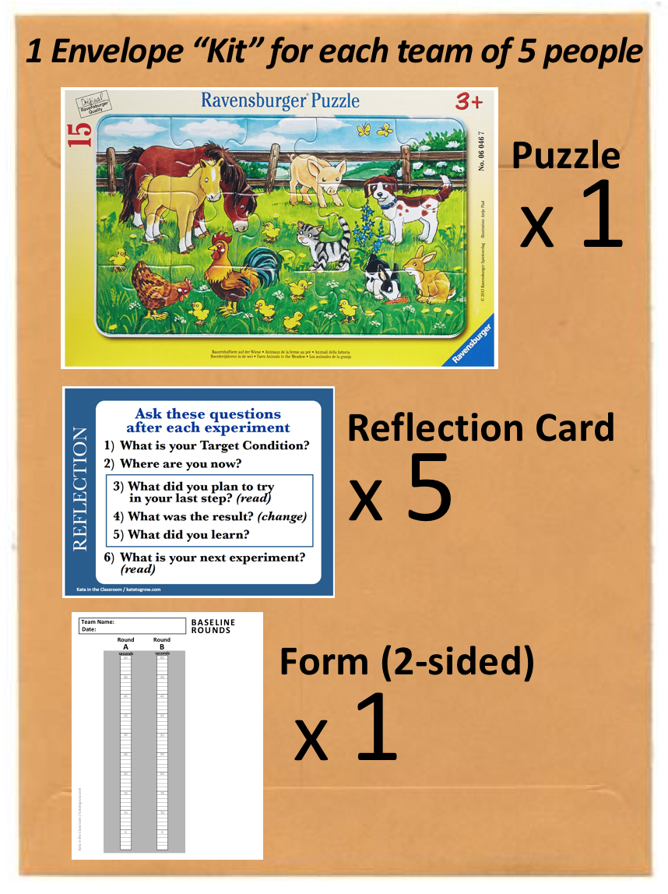
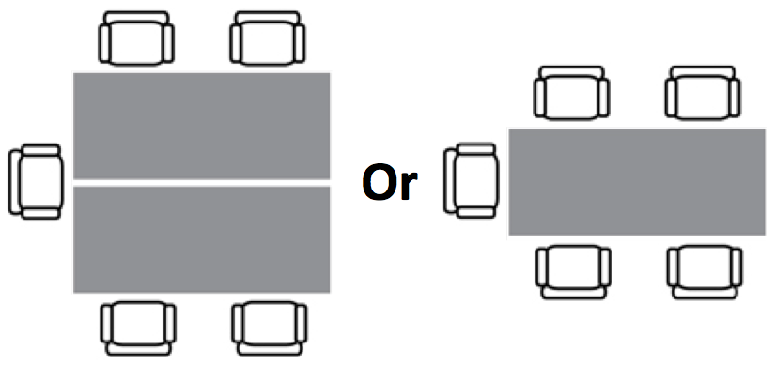
MATERIALS FOR THE KiC-1 EXERCISE
ROOM SETUP
A good student-team size is four or five (4-5) persons. Each team should have their own table island with chairs. Place the chairs around three sides of the table, ideally with the side that's facing the projection screen not having a chair so no one has their back to the Powerpoint projection.
USING THIS POWERPOINT FILE
Use this PowerPoint file to conduct the KiC exercise. The PowerPoint walks you through the exercise step-by-step. In PowerPoint's 'Presenter Mode' the file includes teacher prompts, so you can read key steps and points to make directly from screen. The KiC exercise is easy to facilitate, and gets even easier once you have run it one time!
THE EXERCISE BEGINS WITH THE NEXT SLIDE
Notes:
(Comments for the instructor)

Slide 6

Let’s Practice Scientific Thinking
With a
KATA
Notes:
"Today we're going to practice a Kata for scientific thinking."
Ask the students: "Does anyone know what a "Kata" is?"
→ (A definition is on the next slide)

Slide 7
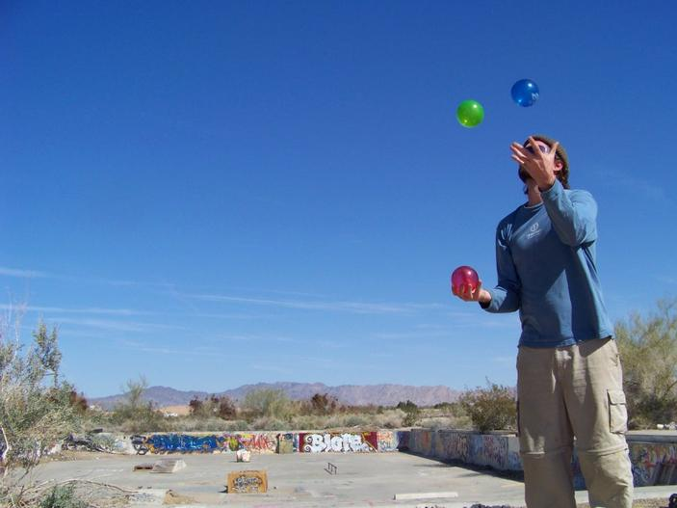
A Kata is a routine you practice at the start, to help you develop new skills!
Notes:
(Read the definition on the slide)
Give some examples from daily life (eg., from music and sports):
Playing musical scales
Practicing your swing or kick

Slide 8

Today we'll practice the pattern of the Improvement Kata
It's a scientific routine
for achieving tough
goals
Notes:
(Read the slide)

Slide 9

Poster
THE FOUR STEPS OF
THE IMPROVEMENT KATA APPROACH
1
3
Get the Direction or
Challenge
Establish your Next
Target
Condition
2
4
Conduct Experiments
to get there
Grasp the Current
Condition
Notes:
Read through the Four Steps of the Improvement Kata pattern, in the numerical order shown.
Point to the corresponding POSTER or drawing in the room.

Slide 10
A FEW KEY POINTS
• You don't have to reach the overall challenge right away.
• The path is not predictable or straight.
• You experiment to get to the next goal,
which makes it scientific.
1
3
Get the Direction or
Challenge
Establish your Next
Target
Condition
2
4
Conduct Experiments
to get there
Grasp the Current
Condition
Notes:
(Read the slide)

Slide 11
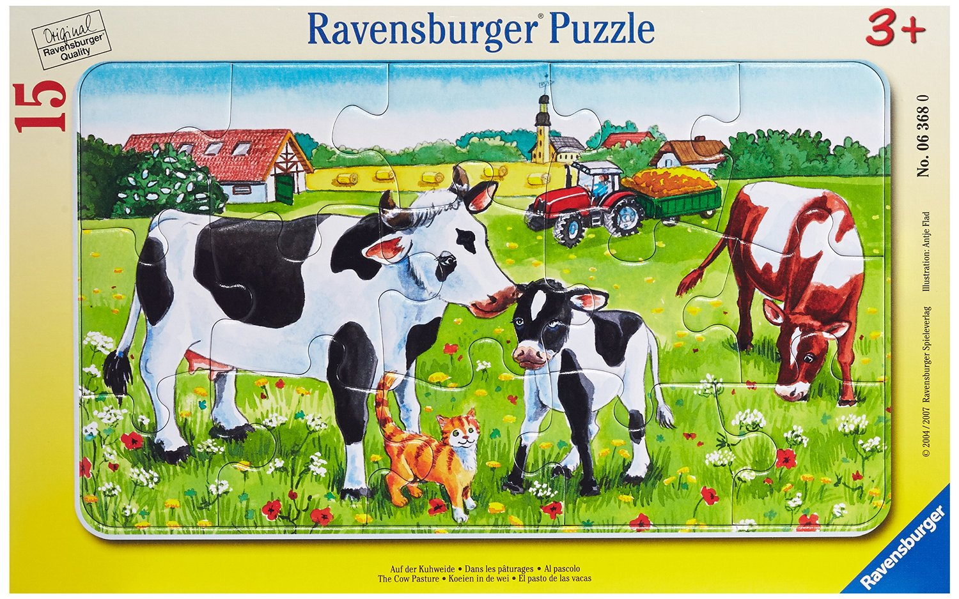
For this exercise we'll build this 15-piece puzzle
several times, and experiment with ways
to do it faster
Notes:
(Read the slide)
(Hand out one 'kit' per team, which contains the following items)
One puzzle / Forms 1 & 2 / One reflection card per person

Slide 12


Go ahead and build the puzzle one time!
Take the puzzle out and study the picture.
Remove the puzzle pieces from the frame.
Put the frame away.
Build the puzzle once, without timing it.
Do the entire exercise without the
puzzle frame
Put the Frame Aside
Notes:
(Read the slide)
Have the teams put the puzzle frame aside (the frame is not used) and build the puzzle once without timing it.

Slide 13



THREE THINGS TO DO NEXT:
Choose a Team Name
Select a Data Recorder
→ Write your team name on the forms in the kit
Select a Timekeeper
→ Each gets a stopwatch
Notes:
(Read the slide, one step at a time, then...)
Ask the Data Recorders to raise their hands.
Ask the Timekeepers to raise their hands. Make sure each has a stopwatch.
Go around the room and ask each team what name it selected.
Point out that Data Recorders can build the puzzle, but Timekeepers do not.

Slide 14

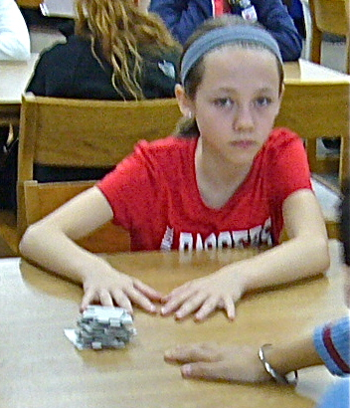
TODAY'S GROUND RULES
(1) "START Position" =
- Puzzle pieces shuffled in random order
- Pieces face down in one stack
- Hands flat on the table
- No talking, you're ready to go
(2) All Teams Start Together
a. Instructor calls "START"
b. Build the puzzle (talking allowed)
c. Note the elapsed time on your form
(3) Don't Write on the Puzzle
Notes:
(Read through the GROUND RULES)

Slide 15
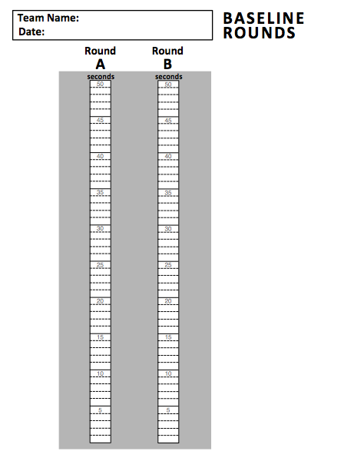
LET'S ESTABLISH A
BASELINE TIME FOR YOUR TEAM
Use this
form
Record your times here
Notes:
(Read the slide)
(Run one or two baseline rounds. Two are recommended.)
Tell the teams to get into START position, and call "START"
Ask students to raise their hand when their team is done building.
Give the teams ~60 seconds between the two rounds, to discuss. Then say, "Please get back into START position."

Slide 16
Now let's do
the four steps of
the Improvement Kata
Notes:
(Read the slide)

Slide 17

Step 1:
UNDERSTAND THE CHALLENGE
1
Get the Direction or
Challenge
Establish your Next
Target
Condition
15
SECONDS
Conduct Experiments
to get there
Grasp the Current
Condition
Notes:
(NOTE: This slide has an animation)
"The CHALLENGE for building this puzzle is to do it in 15 seconds. That's the long-term goal. It's a tough one!"
Stick a large Post-It arrow with '15 Seconds' on Poster 2 under the 'Challenge' circle.
"A challenge is often given to you from above, like an overall goal at work or for a project. It's often not something we get to choose."

Slide 18
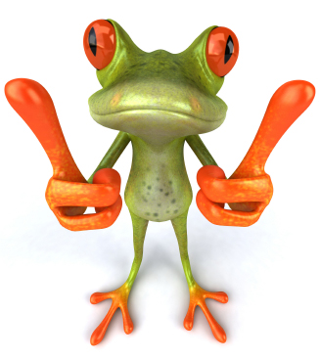
Key Points About:
UNDERSTANDING THE CHALLENGE
We often face challenges in life. No need to worry, because you don't need to get all the way there right away!
A challenge often even gives us a useful sense of direction.
Notes:
(You can also add your own key points)

Slide 19
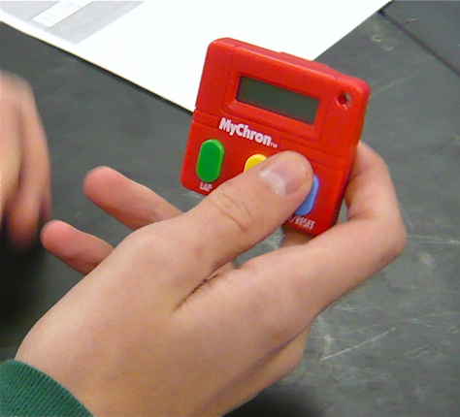
Step 2:
GRASP THE CURRENT CONDITION
What was your team's last baseline time?
Get the Direction or
Challenge
Establish your Next
Target
Condition
2
Conduct Experiments
to get there
Grasp the Current
Condition
Notes:
(NOTE: This slide has an animation)
Ask each team what their last baseline time was.
DO NOT USE AVERAGES, JUST USE THE TEAM'S LAST TIME (most recent)
Say: "OK, this is your team's starting point."

Slide 20
Key Points About:
GRASPING THE CURRENT CONDITION
It's important to understand where you currently are, before you set your next goal.
Don't pull goals randomly out of the air. A team should feel like its goals are meaningful.
Notes:
(You can also add your own key points)

Slide 21

Step 3:
ESTABLISH YOUR NEXT
TARGET CONDITION
3
Get the Direction or
Challenge
Establish your Next
Target
Condition
Conduct Experiments
to get there
Grasp the Current
Condition
Notes:
"Now you can decide where you want to be next, on the way to the bigger Challenge."

Slide 22
Key Points About:
ESTABLISHING YOUR NEXT
TARGET CONDITION
Break a big challenge down into smaller goals.
Set an easier and closer goal that's on the way to your challenge. When you get there you can set the next goal.
Notes:
(You can also add your own key points)

Slide 23
LET'S DEFINE YOUR TEAM'S
NEXT TARGET CONDITION
We can do five (5) rounds of experimenting today
Get the Direction or
Challenge
Establish your Next
Target
Condition
Conduct Experiments
to get there
Grasp the Current
Condition
What puzzle build
time does your team want to reach by the end of today's class?
Notes:
Have the teams discuss and decide the following:
"What puzzle build time does your team want to reach today?... in this class period"
Give the teams 90 seconds to discuss (timer starts on the next slide)

Slide 24

TIME'S UP

Slide 25

LET'S ASK EACH TEAM
Notes:
After the 90 Seconds, ask each team state its last baseline time + the time they propose to reach today.
This a place for some coaching:
Suggest adjusting Target Conditions that are too easy ("I want you to be tougher") or too hard ("Maybe ease off that a bit for today").
Good Target Condition times for the 15-piece puzzle are between 20-28 seconds.
(The challenge of 15 seconds is too much for this class period today. That's not a good Next Target Condition.)

Slide 26

DRAW YOUR TARGET CONDITION LINE
ON THE 'EXPERIMENTING' FORM
TC
Notes:
Each team's Data Recorder should:
Draw a red horizontal line across at the time that equals their Target Condition.
Label the line with the letters "TC".

Slide 27

Step 4:
CONDUCT EXPERIMENTS
TO GET THERE
Get the Direction or
Challenge
Establish your Next
Target
Condition
4
Conduct Experiments
to get there
Grasp the Current
Condition
Notes:
"Now you can do some experiments toward your Target Condition."

Slide 28
Key Points About:
EXPERIMENTING TO GET THERE
You never know in advance exactly how you will achieve a goal.
We need to test the ideas we have. A good way to reach a goal is to experiment rapidly. Try something, see what happens, and then adjust based on what you learn.
To learn from an experiment you should write down what you expect and what actually happens, so you can compare those two things.
Notes:
(You can also add your own key points)

Slide 29


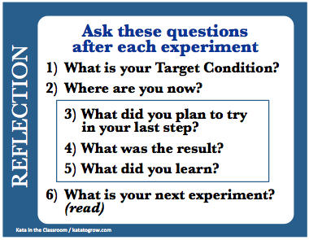
HOW WE'LL EXPERIMENT
Three Steps, and 3 Minutes per Experimenting Round
1) Instructor calls "START"
  - Build the puzzle
  - Note the elapsed time on your form
2) Based on what happened, discuss what
  you plan to do next. Write the ideas you
  want to test onto the form.
3) Then we’ll ask one team the
  reflection questions on the card.
Notes:
Say: "We'll do about 5 rounds of experimenting."
Read the sequence for the experimenting rounds. Say:
"You can change anything you want between rounds, as long as you stay within the Ground Rules.
"You can change who builds, how you build, and you can move yourselves and anything else around."
"You can use support materials (tape, etc.)."
"You can use ideas you see in other teams."

Slide 30
THE EXPERIMENTING FORM
What to record in each round
(Before)
Write down the next ideas you want to test
(After)
Write in how much the time changed compared to the last round
(After)
Mark the elapsed
time
Notes:
Explain how to use the 'EXPERIMENTING' form:
Before each experimenting round each team should jot down the ideas they would like to test in that round.
After the experiment the team should write the elapsed time and the change in time compared to the previous time.

Slide 31
PLEASE PLAN YOUR FIRST EXPERIMENT
Write the ideas you want to test next
on your 'Experimenting' form
Write down the ideas you want to test
Notes:
(Read the slide)
Give the teams 90 seconds to discuss what they want to test in their first experiment. (Use the timer on the next slide.)
Have the teams write in what they want to test in their first experiment. Just a few key words is fine.

Slide 32
TIME'S
UP

Slide 33
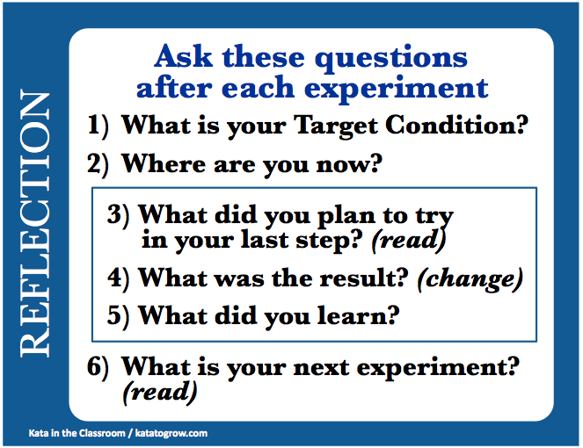
-- HAVE YOUR CARD READY --
After each experimenting round we'll ask
one team this pattern of Reflection Questions
Notes:
(Read the slide and the card)
How to use the card:
After Round 1: Instructor asks one team all the Reflection Questions (always read the card exactly). Have all participants read along with their cards.
Remaining Rounds: Have a person from one team ask the Reflection Questions of another team. Rotate this task from round to round.
The respondent should read from their 'Experimenting' form (a) what the team planned to test in their last experiment, (b) the change in time and (c) what they plan to test in their next experiment.

Slide 34

-- NEXT EXPERIMENT --
Please get into starting position
This
cycle
repeats
• Instructor calls "START"
  Build the puzzle
  Note the elapsed time on your form
• Teams discuss what they plan to do next
  Write ideas you want to test on the form
• Time's up... ask the Reflection Questions!
(Start each round of experimenting on this slide. The 3-minute timer starts on the next slide.)
Notes:
THIS IS THE “TOGGLE” SLIDE. AFTER REFLECTING ON THE LAST EXPERIMENT COME BACK TO THIS SLIDE FOR THE NEXT EXPERIMENT.
(This resets the timer and reminds the teams of the sequence)
Have the teams get into START position.
Initiate the 3-minute timer by going to the next slide as you call out, "Start!"
Do five (5) experimenting rounds if possible. Four (4) rounds is also OK.

Slide 35

ROUND OVER

Slide 36
TIME TO REFLECT
One student asks one other student the Reflection Questions. Everyone follow along with their own card.
NOW GO BACK TO THE “NEXT EXPERIMENT” SLIDE
Notes:
(Read the slide and the card) AFTER THE REFLECTION JUMP BACK TO THE “TOGGLE SLIDE” FOR THE NEXT EXPERIMENTING ROUND
How to use the card:
After Round 1: Instructor asks one team all the Reflection Questions (always read the card exactly). Have all participants read along with their cards.
Remaining Rounds: Have a person from one team ask the Reflection Questions of another team. Rotate this task from round to round.
The respondent should read from their 'Experimenting' form (a) what the team planned to test in their last experiment, (b) the change in time and (c) what they plan to test in their next experiment.

Slide 37

Debrief:
What are the four steps
of the Improvement Kata?
Notice how your team needed
to test its ideas. Things often
don’t go the way we think they will!
What shortcuts did we take
in conducting experiments?
Notes:
If there is not enough time left you can do this DEBRIEF at the start of the next class period. The third point is a lead-in to the KiC-2 exercise.
(1) ASK: Ask the students to name the four steps of the Improvement Kata.
(2) DISCUSS. Use the puzzle experience to discuss (a) how ideas are predictions that need to be tested, and (b) how we often learn useful things when we test an idea, even if the idea doesn't work.
(3) ASK. Try to get the students to discuss ‘how’ they approached the challenge and how they worked together, rather than just solutions they came up with.
(4) ASK. You’re looking to bring up two unscientific shortcuts: (1) Collecting only one data point before deciding what to change. (2) Changing more than one variable at a time, which makes it hard to see cause & effect. [These issues are used as teaching points in the KiC-2 exercise.]

Slide 38
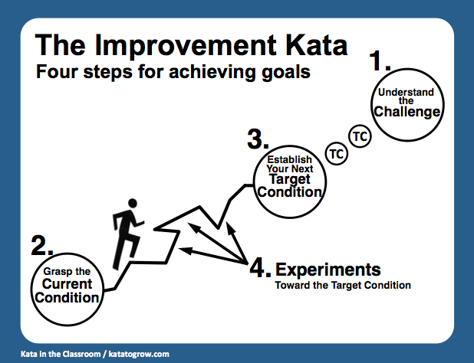
A REFERENCE CARD
on the back of your Reflection Card
Notes:
Point out the Improvement Kata pattern on the back of their card, for students to keep as a reference.

Slide 39
The KiC-2 Follow-On Exercise
The KiC-1 exercise introduces the four steps of the Improvement Kata and helps students recognize that ideas need to be tested. This exercise also takes two non-scientific shortcuts:
  • Students are allowed to change more than one variable at a time.
  • Students collect only one data point before designing their next experiment.
These two points are used as learning opportunities in the KiC-2 exercise, which can follow the KiC-1 exercise, as follows:
Students are allowed to change more than one variable at a time.
  Now run an exercise with the Improvement Kata pattern whereby student teams only change one variable before doing an experiment. It is important to use an exercise that has short cycles, otherwise students may get impatient to try all their different ideas, rather than letting results from one experiment guide them to the next experiment.
Students collect only 1 data point before designing their next experiment.
  Run an exercise with the Improvement Kata pattern whereby student teams collect multiple data points, getting a fuller picture of the situation before making decisions.
THIS SLIDE IS NOT PART OF THE EXERCISE
Notes:
(Comments for the instructor)

Slide 40

ROUND OVER
Notes:
This is an extra timer. If you prefer to run 2.5-minute experimenting rounds, instead of 3-minute rounds, replace the 3-minute timer slide with this slide.

